Slide 1
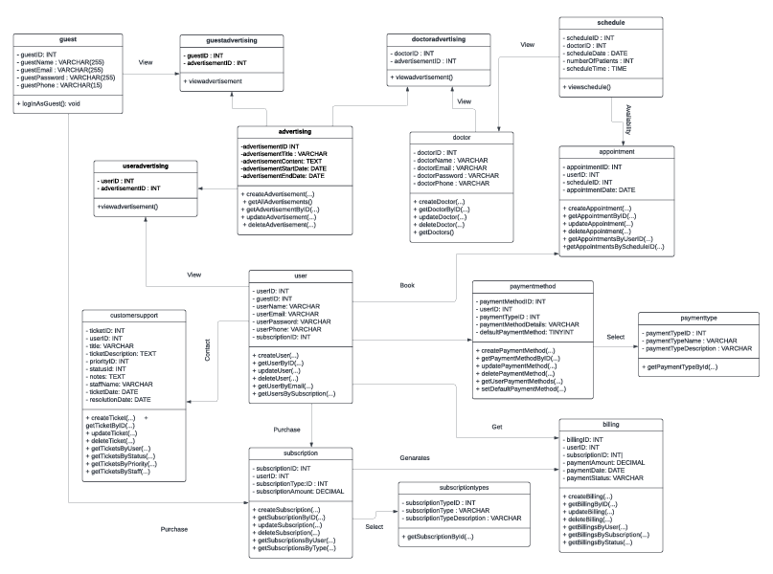
Class Diagram – Healthify –S2

Slide 2
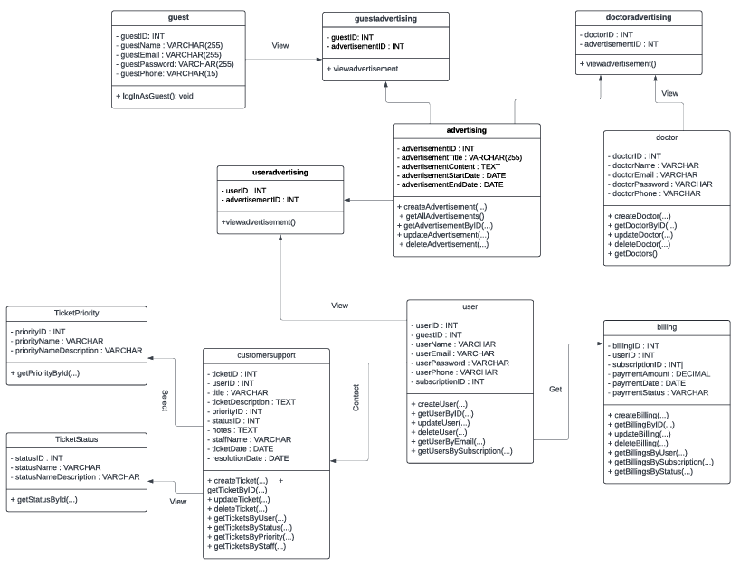
Class Diagram – Healthify –S3

